Slide 1
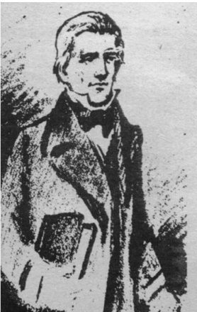
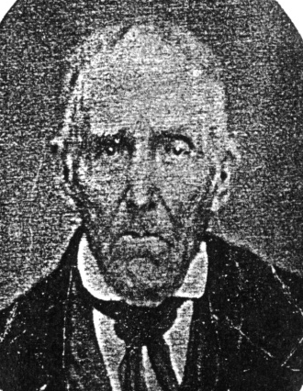
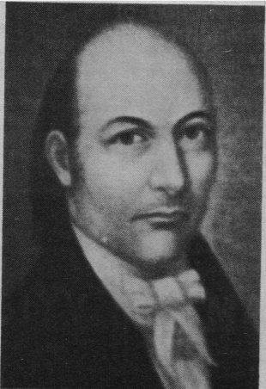
HISTORY OF THE
GEORGIA BAPTIST
ASSOCIATION

Slide 2
Presented by Andy Perryman,
Associational Missionary

Slide 3
The Georgia Baptist Association was organized in 1784, only eight years after Georgia became a state in 1776.
Five churches came together to form the Georgia Association.
  Kiokee
  Fishing Creek
  Upton’s Creek (now Greenwood)
  Red’s Creek (now Abilene)
  Little Brier Creek

Slide 4
Eight men may be considered the Fathers of the Association:
  Daniel Marshall (1706-1784)
  Abraham Marshall (1745-1819)
  Sanders Walker (1740-1805)
  Peter Smith (dates unknown)
  Silas Mercer (1745-1796)
  Loveless Savidge/Savage (c. 1725-1815)
  William Franklin (?-c. 1790)
  Alexander Scott (?- c. 1810)
Notes:
Daniel Marshall was undoubtedly the leading spirit in organizing the association. He was host pastor at the constituting session and the first moderator.
Abraham Marshall was the son of Daniel Marshall and pastor of Kiokee church from 1784 until his death. He was elected moderator 19 times, organized many churches and was a member of the 1789 Georgia Constitutional Convention.
Sanders Walker was probably the first Baptist minister ordained in Georgia and was the first pastor of Fishing Creek church.
Peter Smith was probably the founding pastor of Greenwood church and served as clerk of the association for four years.
Silas Mercer was the founder of several major congregations including Phillips Mill, Bethesda and Powelton. He was the father of Jesse Mercer.
Loveless Savage was probably instrumental in organizing Abilene church where he served as pastor for many years.
William Franklin apparently led in forming the Little Brier Creek church in 1777 and continued as its pastor until 1790.
Alexander Scott, preaching with Daniel Marshall during the Revolutionary War, succeeded his spiritual father as moderator of the association at the May 1785 meeting.

Slide 5
Moderators of the Association
The list of Moderators of the Georgia Association is virtually a Who’s Who list of early Georgia Baptist Leaders.
Daniel Marshall
Abraham Marshall
Alexander Scott
Silas Mercer
Sanders Walker
James Matthews
Jesse Mercer
Billington M. Sanders
Vincent R. Thornton
Patrick Hues Mell
Nathaniel Macon Crawford
James Hines Kilpatrick
William Ambrose Hogan
George C. Steed
Mercer J. Bruce
Homer A. Legg
Claudius Lamar McGinty
Robert C. Daniel
Charles H. Kopp
Law M. Mobley
R. Lee Buice
Sherman Swann Williams
Owen L. Duvall
Tom O. Kay
Charles J. Herring
R. B. Moody, Jr.
Gene K. Hiers
Leon Anthony, Jr.
Harold Tice
Robert C. Black
Charles C. Jordan
William W. Leathers III
Albert W. Huyck, Jr.
Paul C. Reviere
Louis C. Stokes
John Culbreath
R. L. (Bill) Duke
Roy D. Cates
And the list goes on…

Slide 6
Clerks of the Association
For many years there were only two officers of the Association, Moderator and Clerk. Some of the moderators served as clerk.
Peter Smith
Jeremiah Walker
Jesse Mercer
James Anthony
J. N. Brown
William Rabun (Governor)
Jabez P. Marshall
William H. Stokes
Patrick Hues Mell
John Francis Dagg
J. H. Stockton
T. W. Callaway
H. J. Lang
J. W. Binns
A. L. Cummings
Edgar Allan Callaway
C. H. Calhoun
William Turner Callaway
Wilbur A. Orr, Jr.
Robert A. Oslin
J. C. Vaughn
Ben O. Teasley
John Culbreath
Wiley B. Jones
Gloria McAvoy
Lauree Shelton
Turner Callaway

Slide 7
Directors of Missions
The office of Director of Missions was not created in the Georgia Association until 1945.
Robert Willie Johnson (1945-1946)
D. Maurice Smith (1946-1950)
Edgar M. Crosby (1954-1957)
Gordon G. Price (1957-1958)
Sidney H. Odom (1959-1963)
R. L. (Bill) Duke (1963-1968)
Waldo P. Harris III (1969-1986)
Howard E. Germany (1986-1991)
Timothy Sangster (1991-1995)
John P. (Jack) Reynolds (1995-1997)
James Bland (1998-2007)
Andy Perryman (2007-Present)

Slide 8
First Missionary Conference
The Powelton Conference – Friday, May 1, 1801.
Henry Holcombe from Savannah
Francis Ross from Hephzibah Association
Jesse Mercer, Abraham Marshall, John Robertson, Edmund Talbot, Adam Jones and John Harvey from Georgia Association.
THE MISSION BOARD OF THE GEORGIA ASSOCIATION
Notes:
The Powelton Conference that began on Friday, May 1, 1801 had been planned as a day “of fasting and solemn prayer to Almighty God for prosperity in the design.” This day was devoted to religious exercises. Saturday was used for discussion, Sunday for religious services, and Monday and Tuesday to settle on “the design.” Two objects were discussed: (1) to form a missionary society to send two missionaries to the neighboring Creek Indians and (2) to encourage itinerant preaching throughout the state. These proposals were addressed to the Georgia Association for implementation. This was the forerunner of THE MISSION BOARD OF THE GEORGIA ASSOCIATION that began in 1815 to evangelize the poor heathen in idolatrous lands.

Slide 9
The Organization of the General Baptist Association for the State of Georgia
June 27, 1822, Powelton Baptist Church of Christ meetinghouse…
As pastor of the church and moderator of the Georgia Association, Jesse Mercer took charge.
After the worship time the acting clerk read the minutes from the associations which mentioned the meeting. The Ocmulgee and Georgia were favorable and Serepta negative.
Notes:
Cyrus White of the Ocmulgee and Jesse Mercer, William T. Brantly, Winder Hilman, James Armstrong and J. P. Marshall presented their letters of appointment as delegates to the acting clerk, who was likely J. P. Marshall. These two associations by their messengers formed the convention. Mercer was elected moderator, Marshall clerk, and Brantly his assistant. Six people could never make a very significant convention, so the door was opened for other ministers and members of Powelton to share in the proceedings. Consequently, Adiel Sherwood, the father of the original motion to organize this meeting, Humphrey Posey, missionary to the Cherokees, Lee Compere, missionary to the Creeks, and Elisha Perryman, pastor and itinerant preacher from Hephzibah, were added to the membership. Women were not included!

Slide 10
Beginning of Sabbath Schools
Although Adiel Sherwood had organized a Sunday School at Trail Creek church in 1819, the movement did not get started until about 1828. At the annual meeting of the Georgia Association messengers encouraged the organization of Sabbath Schools in all houses of worship.
Notes:
The new work got off to a running start, for in 1829 the churches reported twenty-eight Sabbath Schools with 1,000 pupils!

Slide 11
1833 – A Most Significant Year
Mercer Institute opened at Penfield. Later became Mercer University.
When the Georgia Baptist Convention met that year, only Georgia Association and eight societies were present.
Jesse Mercer bought The Christian Index and moved it to Washington, Georgia.
The association sought peace with the Flint River Association.
The Georgia Association’s third “child”, the Ocmulgee Association, turned its back on missionary heritage and eventually faded away.
Notes:
Jesse Mercer was obviously very influential during the early days of the Georgia Association. Thus when an institute of higher education was established in Penfield, it was named after Jesse Mercer. The leaders of the Georgia Association ran the school for years and most of the faculty served in the churches. Mercer University was mainly a Georgia Association School for thirty-seven years.
The other associations did not even send correspondence. The Georgia Association kept the convention alive and led it through seven lean years. Georgia Association leaders literally controlled the convention for forty-eight years and furnished presidents for many more years.
The voice of Georgia Baptists stayed in Washington until December 1840 then moved to Penfield where it remained until moving to Macon in 1856. Georgia Association got anything it wanted printed in the Index. For years later it assumed the right to have its sermons and news printed in the state paper. The editors were members of Georgia Association churches for twenty-three years.
The battle over missionary emphasis caused much turmoil between the associations that year.

Slide 12
The Southern Baptist Convention
May 8, 1945
Georgia had the largest number of delegates (147) of which Georgia Association had 60.
Georgia Association member and Governor, Honorable Wilson Lumpkin, presided over the opening meeting.
Members of the Georgia Association were influential in the birth of the Southern Baptist Convention.

Slide 13
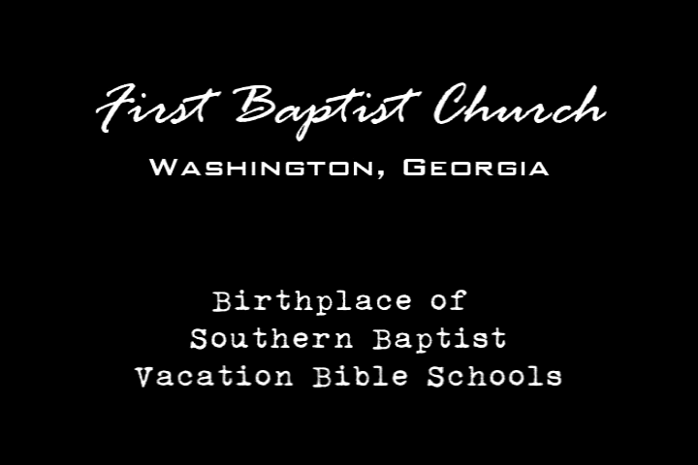
First Vacation Bible School

Slide 14
Penfield Christian Homes
Penfield Baptist Church & Clayton Sanders
Rev. Charles Herring – first director
Began ministry on January 2, 1979
Expanded to North Campus in August of 2007
Expanded to South Campus in January of 2009
Serves over 800 men each year
www.penfieldrecovery.com
Notes:
The Georgia Baptist Association has many firsts to its credit. Among them is Penfield Christian Homes.

Slide 15
Kiokee
Abilene
Fishing Creek
Greenwood
Little Brier Creek
Bethesda
Phillips Mill
Long Creek
Powelton
Providence
Vans Creek
Big Stevens Creek
Botsford
Buckhead
Buffalo
Clarks Station
Doves Creek
Goshen
Head of Brier Creek-Warren
Hebron
Millstone
Sardis
Walker’s Bridge
Bethany
Clouds Creek
Ebenezer
Falling Creek
Horn’s Creek First
Lower Rocky River
Rocky Creek
Rocky River
Savannah First African
Tugalo
Williams Creek
Bark Camp
Brushy Creek
McBean
Buffalo Fork
Head of Brier Creek-Jefferson
Parksville
Rocky Creek – Burke
Skull Shoals
Little Ogeechee River
Oldtown Ogeechee
Beaver Dam Creek
Fork of Tugalo
Red Bank
Sparta
White Ponds
Williamson’s Swamp
Bethlehem
Buckeye
Jordan’s
Little Ogeechee
Nevils Creek
Shockley Ferry
Shoulderbone Creek
Averitts Bridge
Buck Creek
Horeb
North Fort Creek
Ohoopee
Powers
Watery Fork
Island Creek
Danburg
Fishing Creek – Greene
Lower Beaverdam
Beaverdams
Greg’s Creek
Holly Spring
Shiloh
Cabin Creek
Dry Fork
Nails Creek
Trail Creek
Sharon
Big Creek
New Hope
Augusta, Springfield
County Line
Freeman’s Creek
Salem
Bairds
Crawfordville
Plum Branch
Richland
Bethel
Double Branches
Fishing Creek – Baldwin
Philippi
Rocky Creek-Baldwin
Terzah
White Plains
Crooked Creek
Cedar Creek
Hollands Spring
Salem – Morgan
Sugar Creek
Rehoboth
Beulah
Elim
Shoal Creek
Sandy Creek – Morgan
Bethsaida
Bucks Creek
Mount Olives
Little River
Murder Creek
High Shoals
Grove
Walnut Creek
Concord
Union
Antioch
Spirit Creek
Augusta First
Damascus
Greensboro
Sweetwater
Lincolnton
Salem – Lincoln
Washington First
Mt. Stephens
Shoulderbone – Hancock
Siloam
Warrenton
Mineral Springs
Barnett
Bethel
Elim
Hephzibah
Friendship
New Hope
Pine Grove
Antioch-Richmond
New Providence
Beaverdam
Penfield
Ebenezer
Thankful
White Rock
Raytown
Central African
Thomson First
Union Point
Crawford
Macedonia
Enon
Flint Hill
Sandy Cross
Carters Grove
Cliffords Grove
Tabor
Siloam-Lincoln
Marshall
Newtown
Woodville
Wells Creek
Mallorysville
Norwood
Jennings
Loco
Margarets Grove
Tignall
Camak
Messena
Ficklen
Maxeys
Robinson
Columbia Mines
West End
Morningside
Northside
Member Churches
Notes:
Over the past 225 years the Georgia Association has had 175 member churches.

